Slide 1

RNA-Seq primer (part II)

Slide 2

Sequencing: applications
Counting applications
Profiling
microRNAs
Immunogenomics
Transcriptomics
Epigenomics
Map histone modifications
Map DNA methylation
3D genome conformation
Nucleic acid Interactions
Polymorphism/mutation discovery
Bacteria
Genome dynamics
Exon (and other target) sequencing
Disease gene sequencing
Variation and association studies
Genetics and gene discovery
Cancer genomics
Map translocations, CNVs, structural changes
Profile somatic mutations
Genome assembly
Ancient DNA (Neanderthal)
Pathogen discovery
Metagenomics
Notes:
This can all be done on a scale that was impossible before

Slide 3
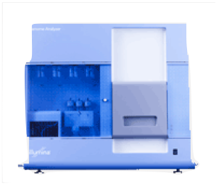

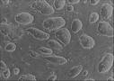
Counting applications
sequencer
Sequenced reads
cells
cDNA
ChIP
Alignment
read coverage
genome

Slide 4
Our typical RNA quantification pipeline
Upload your
sequence data (fastq)
Make report of quality metrics
Output ribosomal contamination metrics report
Align to the ribosome (Bowtie)
Produce RNA-Seq report
% aligned, % intergenic, % exonic, % UTR
Align remaining reads to genome (TopHat) or transcriptome (RSEM)
Produce IGV/UCSC friendly files
Quantify transcriptome
Produce a table with normalized expression values
Call differentially expressed genes
(if multiple samples)
Report pairwise significant genes that are differentially expressed

Slide 5
RNA-Seq libraries: Summary
Sabah Kadri
Maxim Artyomov
Sebastian Kadener

Slide 6
RNA-Seq libraries for quantification

Slide 7
End sequence controls for length bias
Drosophila RNaseH
Slope = -0.657923
Mouse DC data 4h
Slope = -0.59

Slide 8
However no significant gain in power

Slide 9
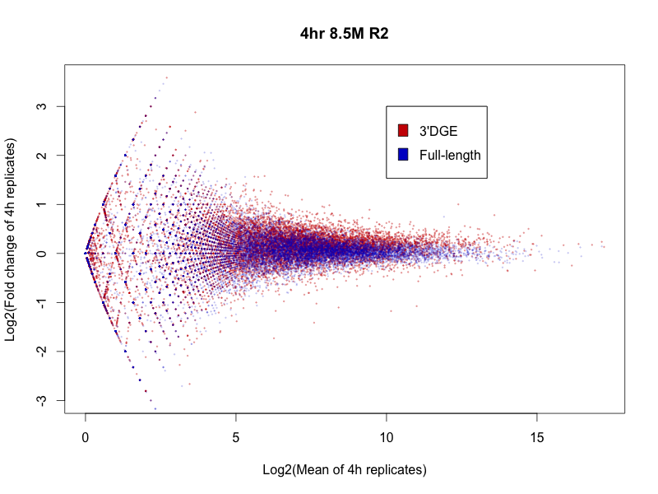
Surprisingly higher variance in DGE

Slide 10
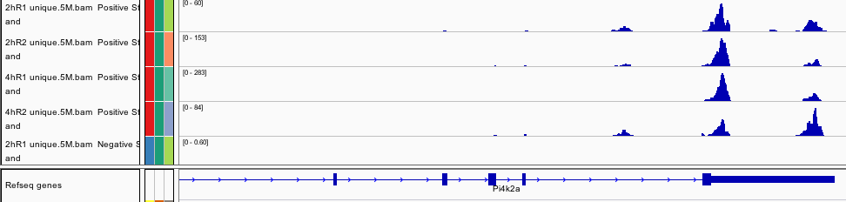
3’ library are more variable

Slide 11
Robustness to low depth: Transcripts detected
Read depth
Alper Kucukural

Slide 12
RSEM/DESeq: 15 mill reads in worm
Alper Kucukural

Slide 13
RSEM/DESeq: 10 mill reads in worm
Alper Kucukural

Slide 14
RSEM/DESeq: 7.5 mill reads in worm
Alper Kucukural

Slide 15
RSEM/DESeq: 5 mill reads in worm
Alper Kucukural

Slide 16
RSEM/DESeq: 2.5 mill reads in worm

Slide 17
RSEM/DESeq: 1 mill reads in worm

Slide 18
Robustness of DGE to low depth
Read depth

Slide 19
Final considerations: The steps of Sequencing analysis
Filter reads (fastq file) by removing adapter, splitting barcodes.
Evaluate overall quality, look for drop in quality at ends. Trim reads if ends are of low quality
Alignment to the genome
Use transcriptome if available
Filter out likely PCR duplicates (reads that align to the same place in the genome
Evaluate ribosomal contamination
What percent of reads aligned
Reconstruct(?)
Quantify
Normalize according to application

Slide 20
What does significance means?
RNA-Seq: The gene is expressed
ChIP-Seq: Factor binds the region
CLIP-Seq: Protein binds RNA region

Slide 21
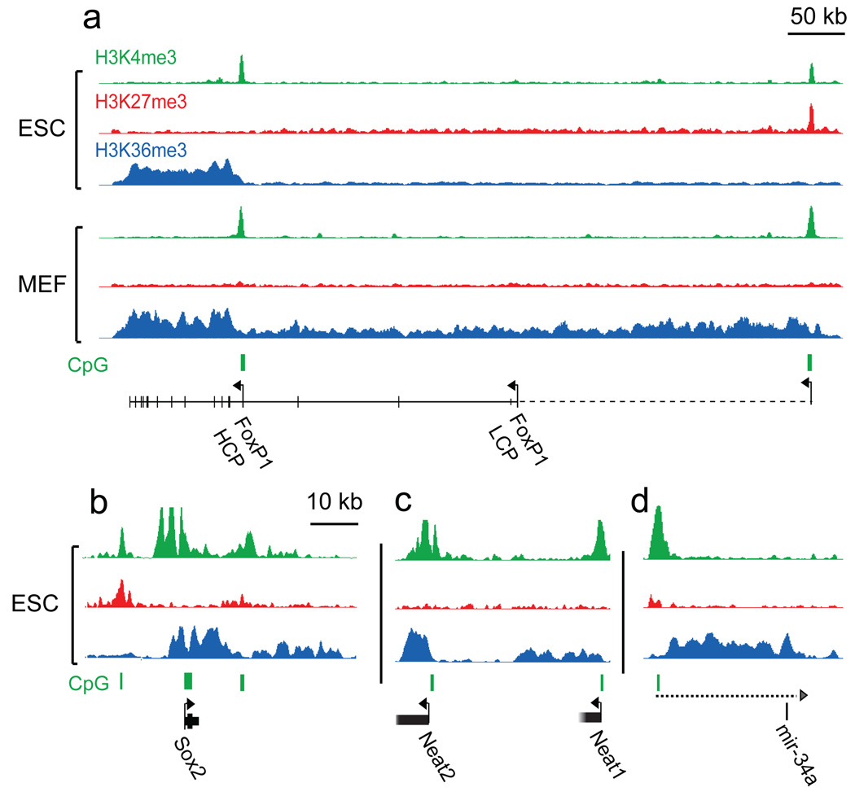
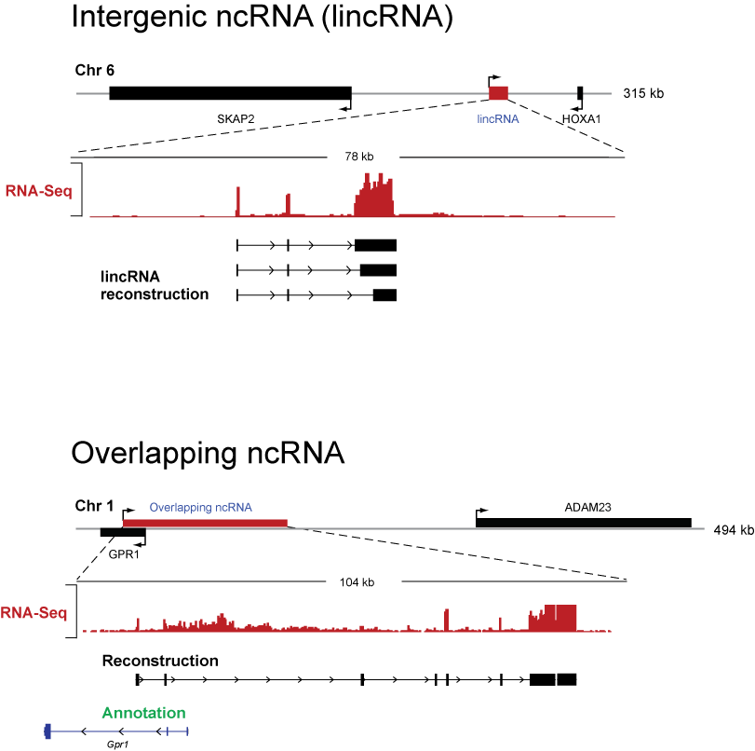
How do we find peaks?
Short modification
Long modification
Discontinuous data
Scripture is a method to solve this general question

Slide 22
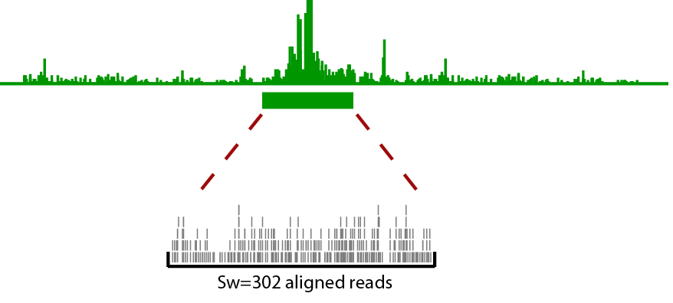
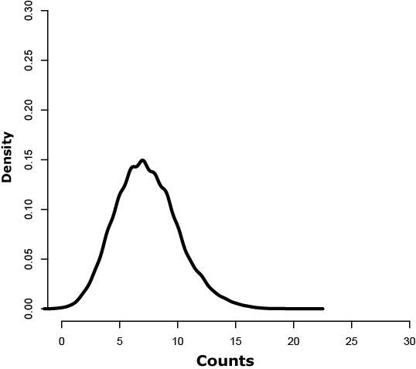
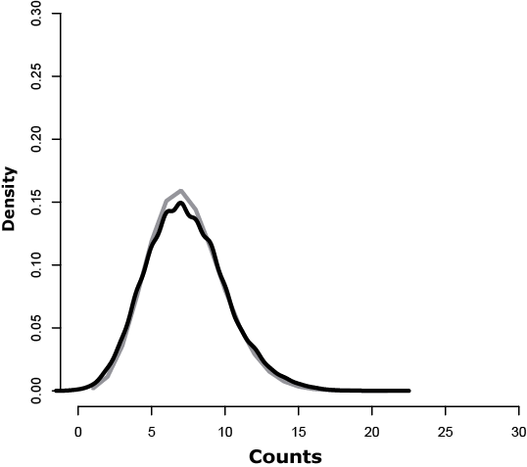
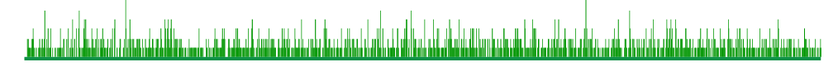
Our approach
Permutation
Poisson
α=0.05
We have an efficient way to compute read count p-values …

Slide 23
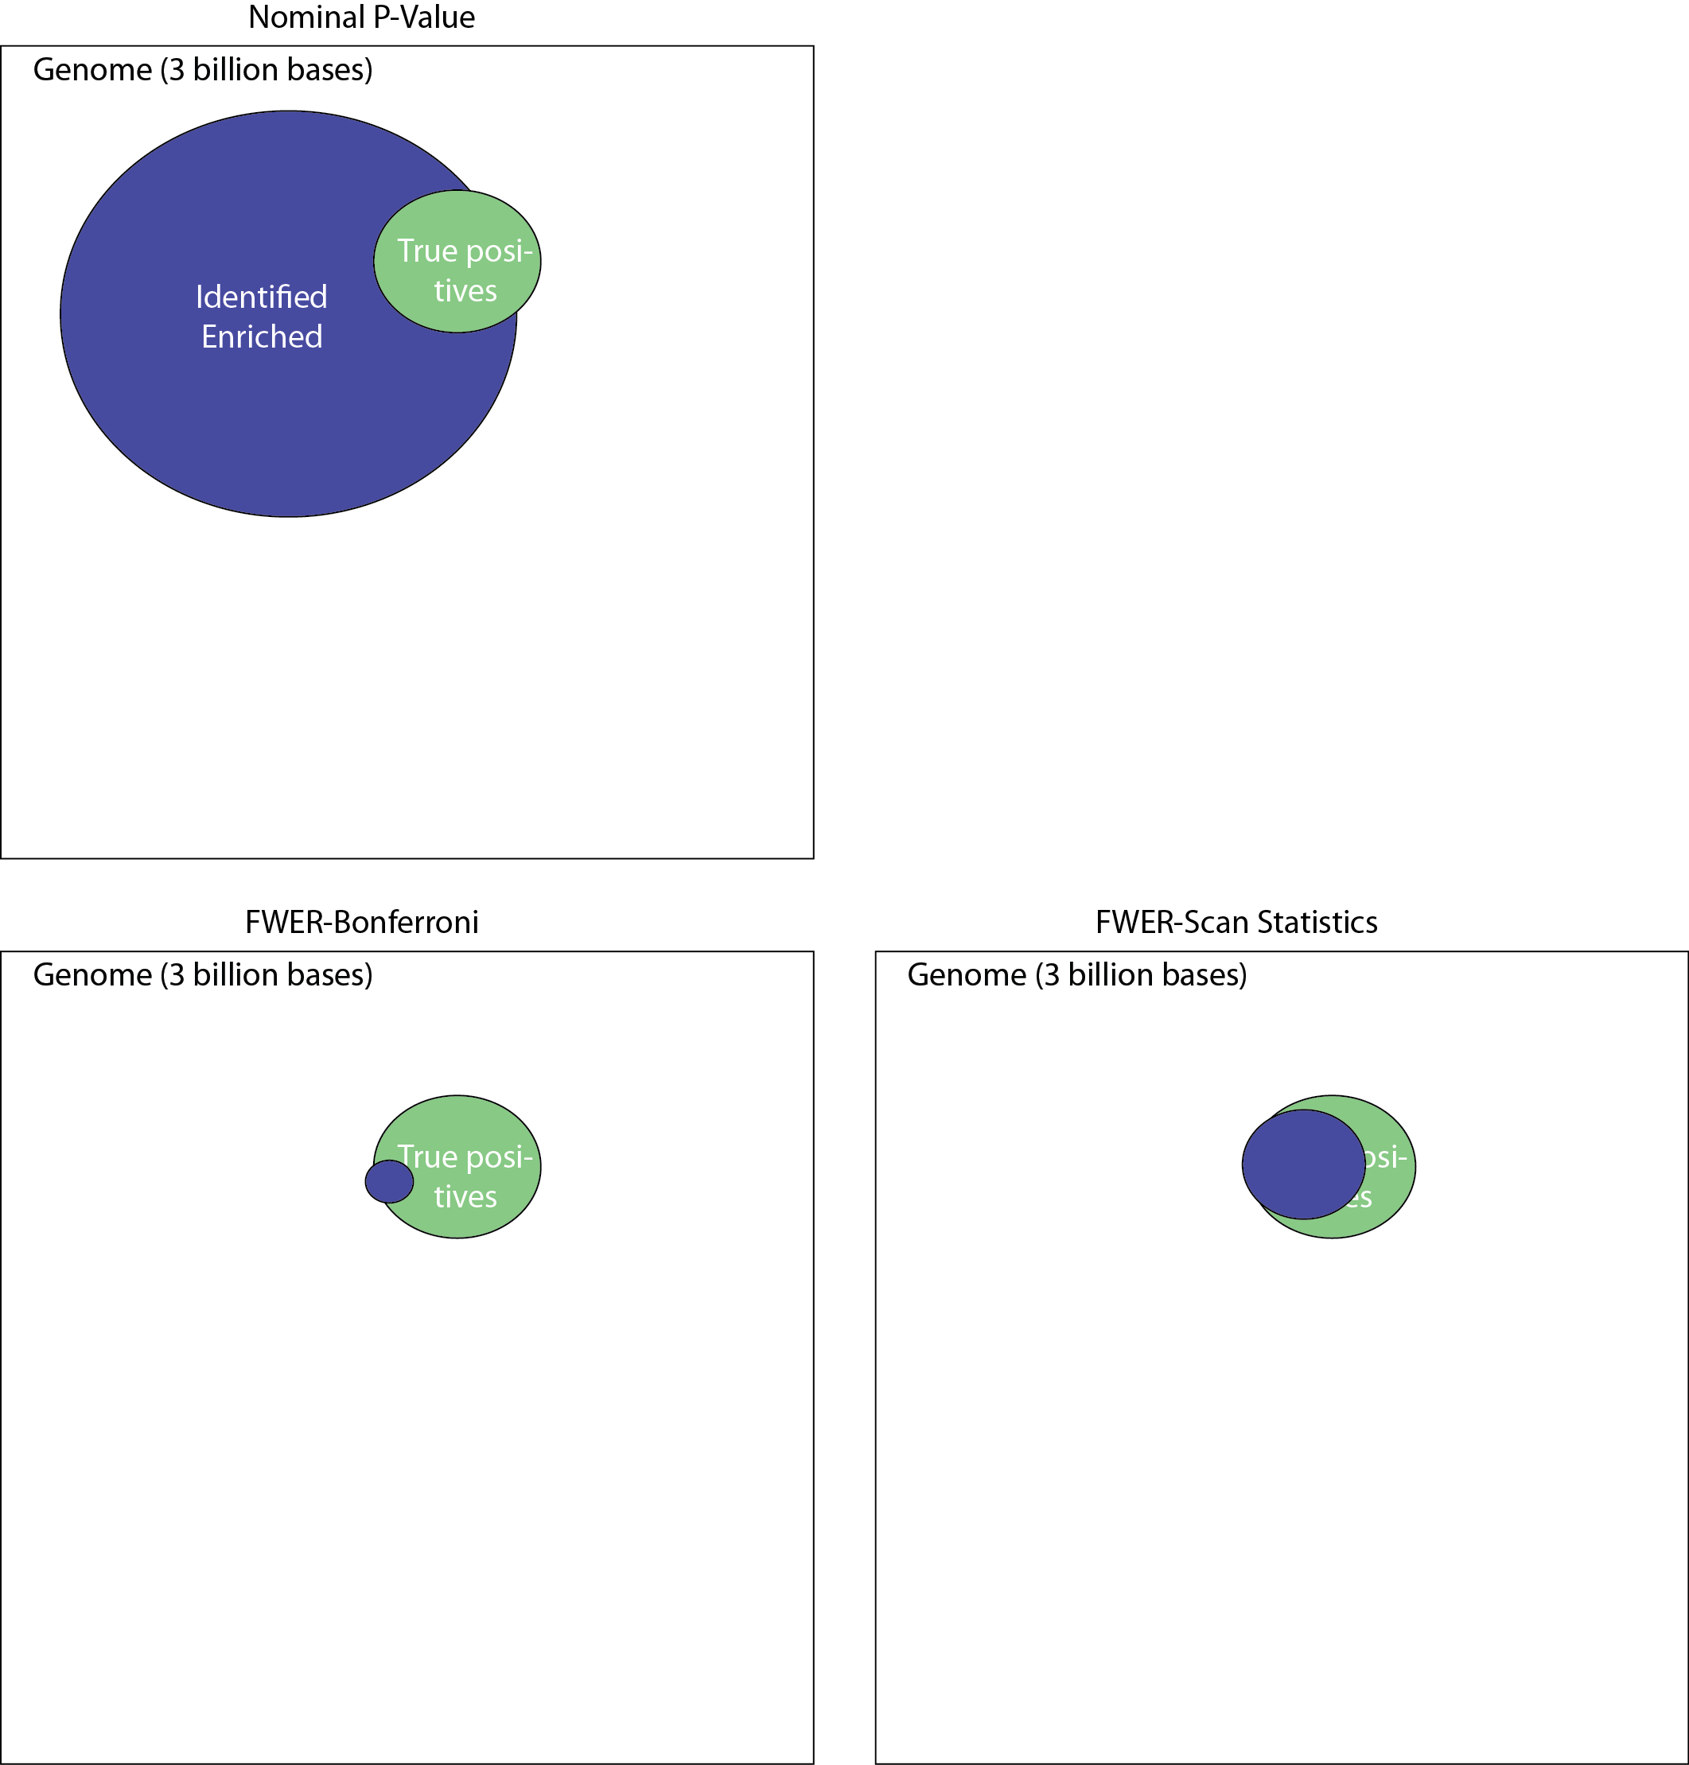
The genome is large, many things happen by chance
Expected ~150,000,000 bases
We need to correct for multiple hypothesis testing

Slide 24
Bonferroni correction is way to conservative
Correction factor 3,000,000,000
Bonferroni corrects the number of hits but misses many true hits because its too conservative – How do we get more power?

Slide 25
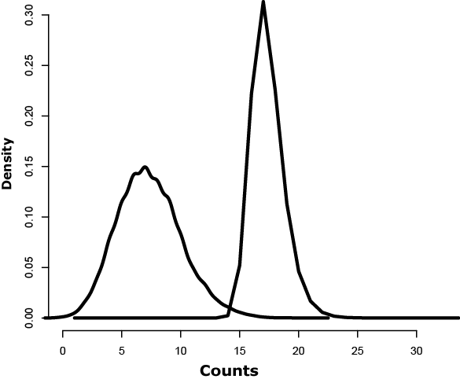
Controlling FWER
Max Count distribution
α=0.05
α_{FWER}=0.05
Given a region of size w and an observed read count n. What is the probability that one or more of the 3x10⁹ regions of size w has read count >= n under the null distribution?
We could go back to our permutations and compute an FWER: max of the genome-wide distributions of same sized region)→
but really really really slow!!!
Count distribution (Poisson)

Slide 26
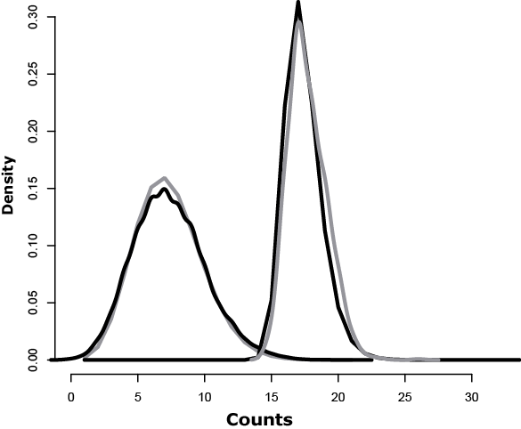
Scan distribution, an old problem
Is the observed number of read counts over our region of interest high?
Given a set of Geiger counts across a region find clusters of high radioactivity
Are there time intervals where assembly line errors are high?
Scan distribution
α=0.05
α_{FWER}=0.05
Thankfully, the Scan Distribution computes a closed form for this distribution.
ACCOUNTS for dependency of overlapping windows thus more powerful!
Poisson distribution

Slide 27
Scan distribution for a Poisson process
The probability of observing k reads on a window of size w in a genome of size L given a total of N reads can be approximated by (Alm 1983):
where
The scan distribution gives a computationally very efficient way to estimate the FWER

Slide 28
By utilizing the dependency of overlapping windows we have greater power, while still controlling the same genome-wide false positive rate.

Slide 29
Segmentation method for contiguous regions
Example : PolII ChIP
Significant windows using the FWER corrected p-value
Merge
Trim
But, which window?

Slide 30
We use multiple windows
Small windows detect small punctuate regions.
Longer windows can detect regions of moderate enrichment over long spans.
In practice we scan different windows, finding significant ones in each scan.
In practice, it helps to use some prior information in picking the windows although globally it might be ok.

Slide 31
Applying Scripture to a variety of ChIP-Seq data
200, 500 & 1000 bp windows
100 bp windows

Slide 32
Can we identify enriched regions across different libraries?

Short modification

Long modification
Using chromatin signatures we discovered hundreds of putative genes.
What is their structure?
Discontinuous data: RNA-Seq to find gene structures for this gene-like regions

Slide 33
Scripture for RNA-Seq:
Extending segmentation to discontiguous regions

Slide 34
Transcript reconstruction problem as a segmentation problem
Challenges:
Genes exist at many different expression levels, spanning several orders of magnitude.
Reads originate from both mature mRNA (exons) and immature mRNA (introns) and it can be problematic to distinguish between them.
Reads are short and genes can have many isoforms making it challenging to determine which isoform produced each read.
100s bp
10s kb

Slide 35
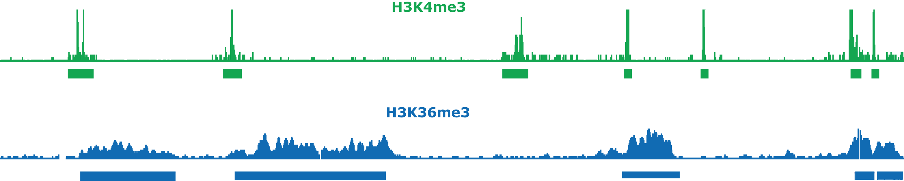
Scripture: Genome-guided transcriptome reconstruction
Statistical segmentation of chromatin modifications uses continuity of segments to increase power for interval detection
RNA-Seq
If we know the connectivity of fragments, we can increase our power to detect transcripts

Slide 36
Longer (76) reads increased number of junction reads
intron
Exon junction spanning reads provide the connectivity information.
Notes:
Animate the exons without segments.

Slide 37
The power of spliced alignments
Protein coding gene with 2 isoforms
Read coverage
Exon-exon junctions
Alternative isoforms
Aligned read
Gap
Notes:
Lets look at how our data looks with 76 b reads.
Shown on the top is a the loci of an annotated gene with two known isoforms (red and green).
The read coverage below shows clear enrichments of all 4 exons. Are both or only the bottom isoform expressed?
Lets start by zooming in on the first two exons. Reads that
If we zoom we see that there are indeed spliced reads spanning the first two exon junction I will represent an aligned SPLICED read as a “dumbbell” with each thick end representing the aligned sequence and the horizontal line the gap between the aligned portions. There are many such reads for this robustly expressed gene and they help us
HELP US CONNECT THE TWO SEGMENTS INTO A TRANSCRIPT, AND (2) IF EACH SMALL EXON IS too small or LOWLY EXPRESSED TO BE FOUND ON ITS OWN, AS A CONNECTED PAIR WE MAY FIND THEM.
NOW, LET’S LOOK AT THIS ALTERNATIVELY SPLICED EXON. WITH SPLICED READS WE CAN IDENTIFY THE TWO ALTERNATIVE ISOFORMS

Slide 38
Statistical reconstruction of the transcriptome
Step 1: Align Reads to the genome allowing gaps flanked by splice sites
genome
Step 2: Build an oriented connectivity graph using every spliced alignment and orienting edges using the flanking splicing motifs
The “connectivity graph” connects all bases that are directly connected within the transcriptome
Notes:
WE START BY alignING reAds to the genome with gaps (e.g. using TopHat). WE FIRST FOCUS ONLY on reads that aligned with a gap flanked by splice sites (THE DUMBELLS).
In the second step we use this splice reads to build a connectivity graph and give the Genome a new topology in which each base is connected to its neigbohrs as in the linear genome but also connected to any other base at the other end of a gap connecting them. We orient these connections based on the splice sites flanking them. This connections recapitulate the original topology of the RNA sequenced in now the discontiguous.
The connectivity graph then gives the genome a new topology that captures the original contiguity of the RNA.

Slide 39
Statistical reconstruction of the transcriptome
Step 3: Identify “segments” across the graph
Step 4: Find significant segments
Notes:
We now rely on the connectivity graph to apply a method similar to the one we used to determine regions enriched in chromatin data to regions (which now may be disconnected) enriched in RNASeq reads. For example the region demarcated by the red path would be significant and corresponding to one of the original isoforms.
Once we have enriched paths, they translated into putative isoforms.
Another significant path will be the one that goes through the larger exon (here in green) and that corresponds to the isoforms that include this exon.
We then use paired end data to join paths that may have not had enough spliced read support and also to remove paths that require paired reads to be at a distance not likely given the insert size distribution and to gauge whether or not we’ve reached the 3’ end of the isoform.

Slide 40
Can we identify enriched regions across different data types?

Short modification

Long modification

Discontinuous data
Are we really sure reconstructions are complete?

Slide 41
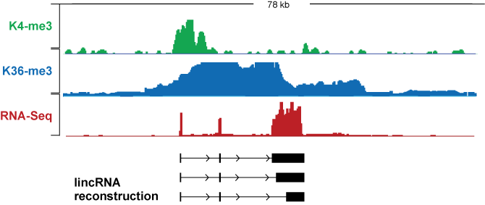
RNA-Seq data is incomplete for comprehensive annotation
Library construction can help provide more information. More on this later

Slide 42
Visualization tricks & Tips
Viewing normalized data
Downsampling reads to avoid crashes
Gene lists
Sessions

Slide 43
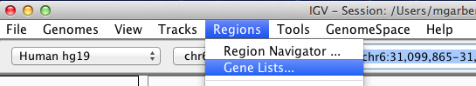
Viewing several loci simulateneouly: Gene lists

Slide 44
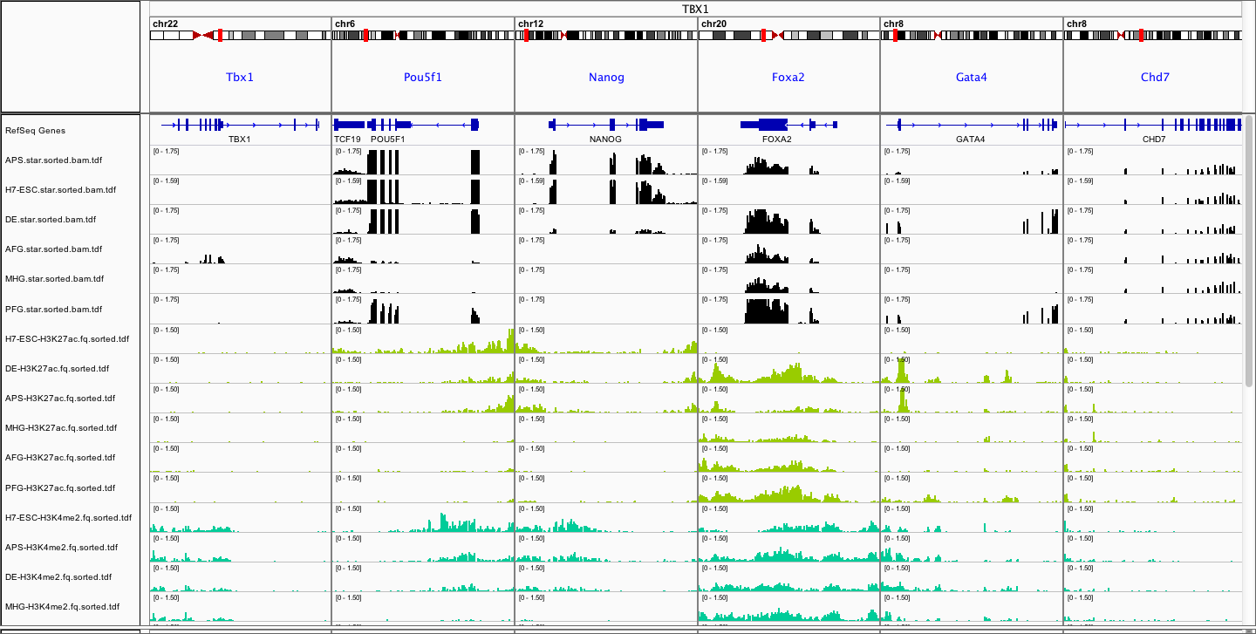
Viewing several loci simulateneouly: Gene lists

Slide 45
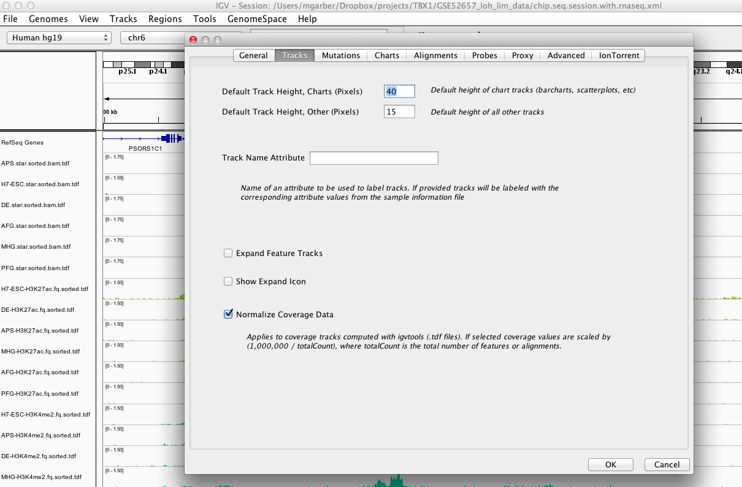
Normalizing tracks
You can use simple read depth normalization for comparison of different tracks

Slide 46
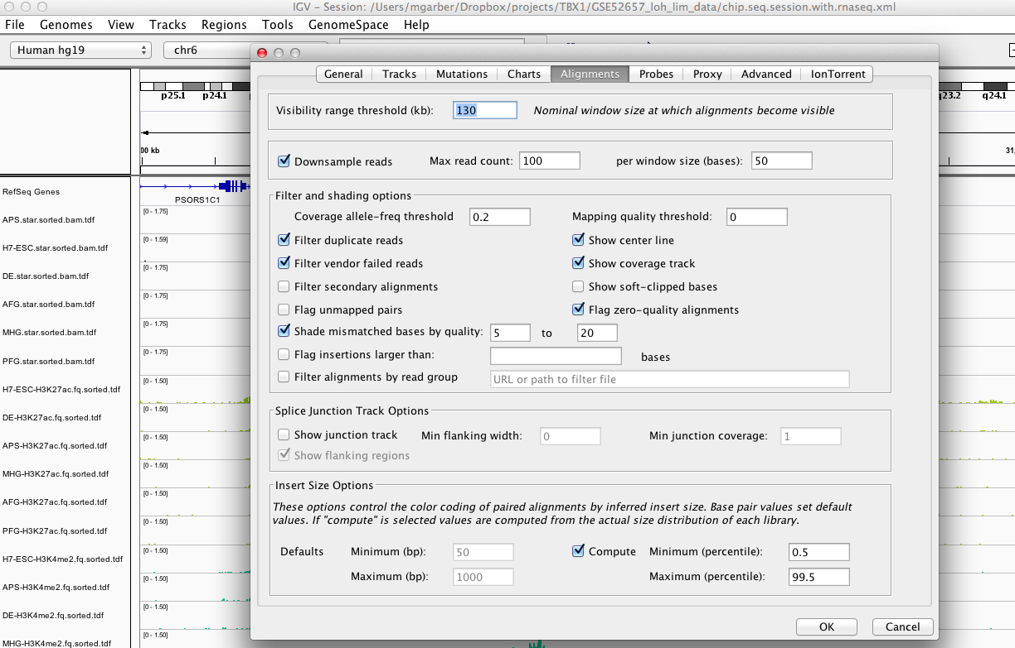
Configure your alignment display
Downsampling reads is critical when loading the full alignments.
When you are loading reads, downsampling ensures that regions with high coverage result in IGV running out of memory.

Slide 47
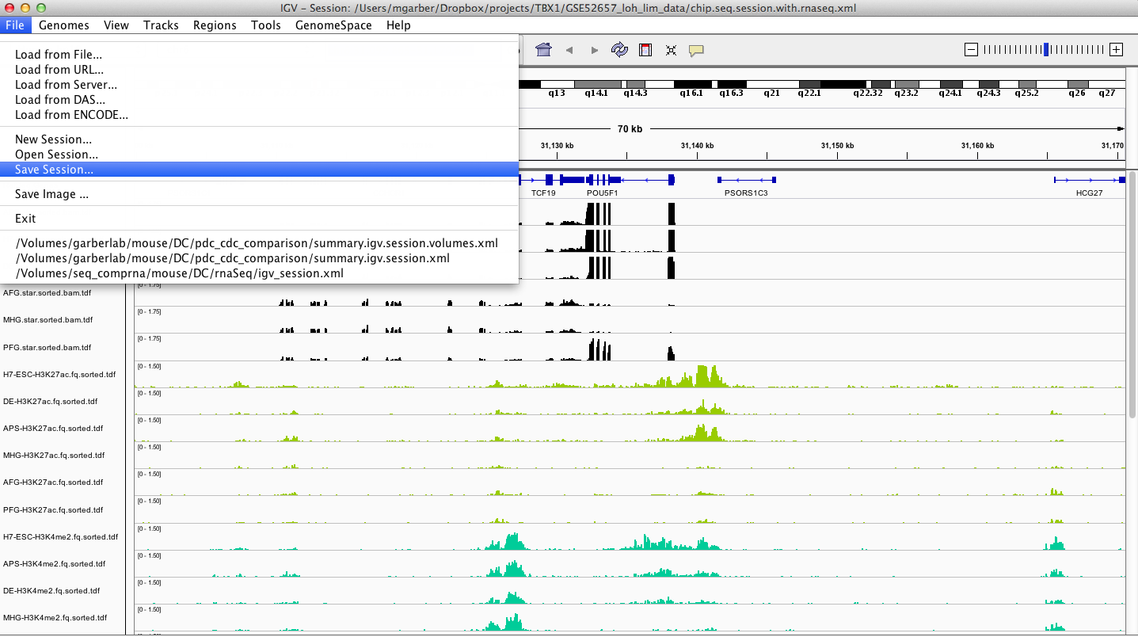
Saving sessions
Sessions allows you to store a set of desired tracks along with any setting you want

